Slide 1
🔧 Training Outline
Course: Foundations of Data Analysis
Week 1 Theme: From Raw Data to First Insights
Target Audience: Beginners / Mixed-background learners
Delivery Mode: Lecture + Live Demo + Hands-on Lab

Slide 2
Learning Outcomes
By the end of Week 1, learners will be able to:
Explain what data analysis is and why it matters
Distinguish between different types and formats of data
Identify common data quality issues
Use Jupyter / Colab to load a CSV dataset
Perform basic data inspection and descriptive statistics using Python
Extract simple, meaningful insights from a real dataset

Slide 3
Concept Covered
What is Data Analysis?
Why It Matters in Decision-Making
Types of Data: Structured vs. Unstructured
Data Quality & Common Issues
Introduction to Python & Jupyter
Descriptive Statistics
Hands-on Lab: Exploring Student Performance Data

Slide 4
What Is Data Analysis?
Data analysis is the process of inspecting, cleaning, transforming, and modeling data to discover useful information, draw conclusions, and support decision-making.
Main goal: Convert raw data into meaningful insights
It goes beyond reporting - it involves asking why and what if
The Data-Driven Decision Cycle
Ask – Clearly define the problem or question
Collect – Gather relevant data
Clean – Address errors and missing values
Analyze – Summarize, visualize, and model the data
Act – Make informed decisions and communicate results
Example: Universities analyze student data to reduce dropout rates.

Slide 5
Real-World Impact of Data Analysis
🏥 Healthcare: Predicting disease outbreaks
🏦 Finance: Real-time fraud detection
🌾 Agriculture: Crop yield forecasting using satellite data
🎓 Education: Early identification of at-risk students
In Kenya, data literacy is a national priority under the Digital Economy Blueprint.

Slide 6
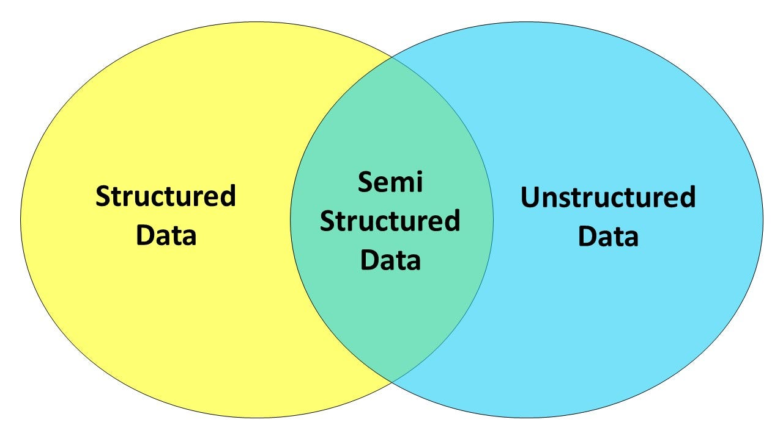
Data Types, Formats and Structures
There are three different types of data structures
Data Type | Description | Example
Structured | Organized in rows and columns | Excel files, SQL tables
Unstructured | No predefined structure | Emails, images, social media
Semi-structured | Partially organized | JSON, XML
This course focuses primarily on structured data, such as CSV files.
Common Data Formats
CSV (.csv) – Lightweight and widely supported
Excel (.xlsx) – Multiple sheets and formulas
JSON – Common in web APIs
Database tables – MySQL, PostgreSQL
We begin with CSV files due to their simplicity and versatility.

Slide 7
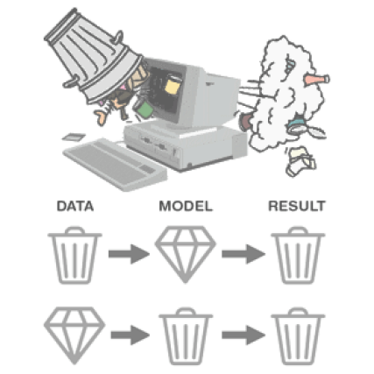
What Is “Good” Data?
Good-quality data is:
✅ Accurate
✅ Complete
✅ Consistent
✅ Relevant
Poor-quality data leads to poor decisions
— garbage in, garbage out.
Common Data Problems
❌ Missing values (NaN)
❌ Duplicate records
❌ Outliers (e.g., unrealistic ages)
❌ Inconsistent formatting (e.g., “Male”, “M”, “m”)
❌ Incorrect data types

Slide 8
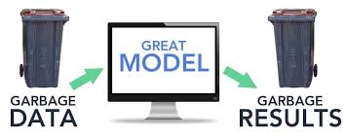
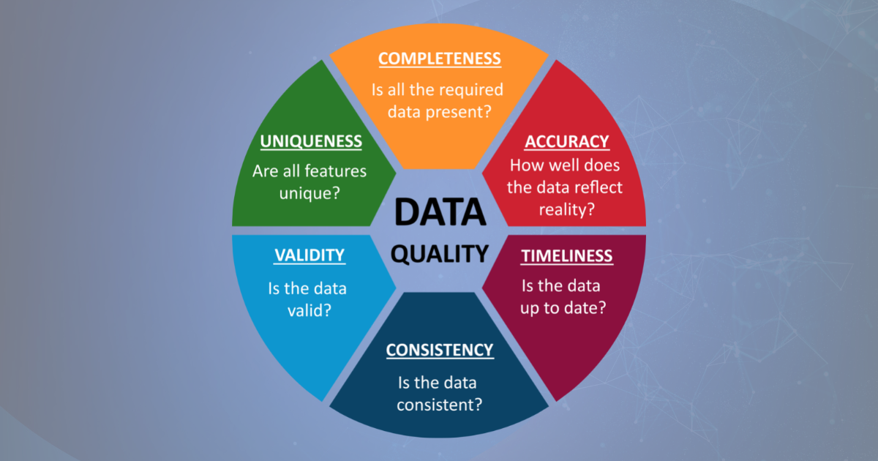
Quality of the Data
Good Quality Data + Good Quality Model = Good Results
High-quality data, defined by accuracy, completeness, and consistency, is the critical foundation for data analysis.
This helps in ensuring models learn accurate patterns to produce reliable, trustworthy, and actionable results.
Combining this with a well-designed, appropriate model prevents, garbage-in, garbage-out scenarios, leading to superior performance and informed decision-making.

Slide 9
Introduction to Pivot Data Analysis
Turning Raw Student Data into Actionable Insights
Key Points:
📊 750+ million users worldwide — most common business tool
💼 Used daily in banks, NGOs, universities, and government in Kenya
✅ No coding required — ideal for beginners
🔧 PivotTables = instant summaries without formulas
🚀 Foundation for Power BI & Python later
You’ll be job-ready faster by mastering Excel first.

Slide 10
Our Dataset – Student Performance (1,500 Records)
What’s in the file?
Student ID, Gender, Age, Program, Year of Study
Academic Scores: Math, English, Data Skills Pre-Test
Behavioral Metrics: Attendance %, Study Hours/Wee
Background: Family Income, Scholarship Status
Outcomes: Previous CGPA, Final Grade, At Risk of Retaking the Course or Not (Yes/No)

Slide 11
What Is a PivotTable?
Definition:
A PivotTable is an interactive Excel tool that summarizes large datasets by grouping, filtering, and calculating values-without writing formulas.
Why it’s powerful:
Drag-and-drop interface
Instantly answer questions like:
  “What’s the average Final Grade by Program?”
  “How many at-risk students are in Business?”
Updates automatically when data changes

Slide 12
Creating Your First PivotTable
Instructions:
Open student performance.csv in Excel
Select any cell in the data
Go to Insert → PivotTable → OK
In the PivotTable Fields pane:
  Drag Program to Rows
  Drag Final Grade to Values (it will default to Average)
✅ You now see average final grade per program!
Tip: Right-click any value → “Value Field Settings” to change from Average to Count, Sum, etc.

Slide 13
Common PivotTable Applications
PivotTables can answer common analytical questions quickly:
Analytical Question | PivotTable Configuration
Number of students per program | Rows: Program; Values: Student ID
Average attendance by gender | Rows: Gender; Values: Attendance Pct (Average)
Percentage of at-risk students by income level | Rows: Family Income Level; Values: At Risk (Average × 100)
Average study hours by scholarship status | Rows: Scholarship Status; Values: Study Hours Per Week

Slide 14
Using Filters and Slicers
PivotTables become more powerful when interactivity is added.
Use Report Filters to filter data by variables such as Year of Study
Insert Slicers to visually filter by Gender, Program, or At-Risk status
Combine multiple PivotTables and slicers to create interactive dashboards
This approach mirrors professional Excel dashboards used by decision-makers.

Slide 15
Identifying At-Risk Students
To analyze student risk patterns, create the following PivotTable:
Rows: Program
Columns: Family Income Level
Values: At_Risk (Average)
Format results as percentages
Key insight:
Students from low-income backgrounds, particularly in Education and Agriculture programs, exhibit higher risk levels and may require targeted support.
This demonstrates data-driven decision-making.

Slide 16
Best Practices and Common Mistakes
Best Practices:
Ensure source data has no empty rows or columns
Use consistent category names (e.g., “Male/Female”)
Refresh PivotTables whenever the dataset changes
Common Mistakes to Avoid:
Editing values inside the PivotTable
Saving PivotTables in CSV format (use .xlsx instead)

Slide 17
Next Steps and Homework
Assignment
Open student_performance.csv in Excel
Create three PivotTables to answer the following:
  Which program has the highest average final grade?
  How does attendance relate to at-risk status?
  How does scholarship status influence study hours?
Take a screenshot of your best PivotTable and share it in the class WhatsApp group

Slide 18
Introduction to Python for Data Analysis
Python is preferred because it is:
Easy to learn
Supported by powerful libraries (pandas, numpy, matplotlib)
Widely used by organizations such as Google, NASA, WHO, and Safaricom
Free and open-source
No prior programming experience is required.
Jupyter Notebook – Your Data Lab
Interactive environment for running code
Combines code, text, and visualizations
Excellent for learning and collaboration
Available via Anaconda or Google Colab
Tip: Google Colab is ideal for low-resource computers.

Slide 19
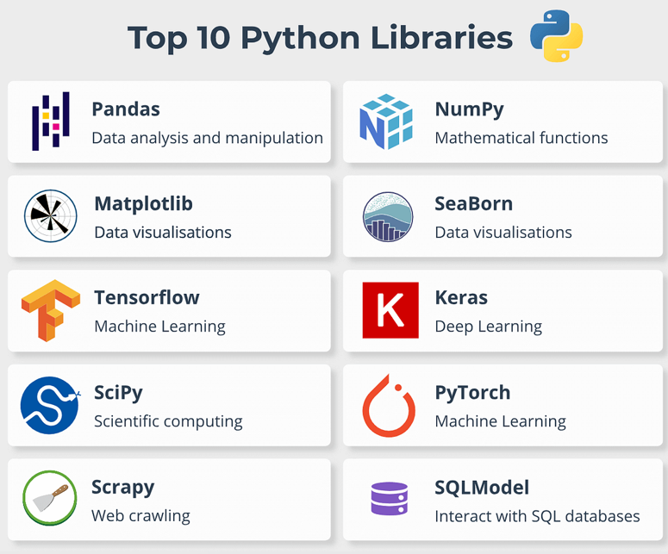
Core Python Libraries Used in This Course

Slide 20
What Is a Data Frame?
A DataFrame is a table of data
Rows represent observations
Columns represent variables
Similar to an Excel worksheet, but programmable
import pandas as pd
df = pd.read_csv('student_performance_week1.csv')

Slide 21
Descriptive Statistics – The Basics
Key summary measures include:
Mean
Median
Standard deviation
Minimum and maximum
Count
These statistics help describe the distribution of the data.
Hands-On Demo – Loading and Inspecting Data
df = pd.read_csv('student_performance_week1.csv')
df.head()
df.info()
df.describe()
These steps will be repeated during the lab session.
Understanding the Dataset
Dataset: student_performance_week1.csv
Observations: 150 students
Variables:
  Student_ID, Name, Gender, Age, Program
  Math_Score, English_Score, Data_Skills_PreTest
  Attendance_Pct, Final_Outcome
The objective is to identify patterns and relationships.

Slide 22
Variables Definition
Variable | Type | Description
`Student ID` | ID | Unique identifier
`Gender` | Categorical | Male/Female
`Age` | Integer | 17–25
`Program` | Categorical | Computer Science, Education, Business, Nursing, Agriculture
`Year of Study` | Integer | 1–4
`Math Score` | Float (0–100) | Baseline math ability
`English Score` | Float (0–100) | Baseline language ability
`Data Skill Pre-Test` | Float (0–100) | Prior exposure to data tools
`Attendance Pct` | Float (0–100) | Class attendance %
`Study Hours Pe Week` | Integer | Self-reported study time
`Parental Education` | Categorical | None, Secondary, Diploma, Degree
`Family Income Level` | Categorical | Low, Medium, High
`Has Internet at Home` | Binary | Yes/No
`Uses Learning Apps` | Binary | Yes/No
`Participates in Group Work` | Binary | Yes/No
`Previous CGPA` | Float (0–5.0) | Cumulative GPA from prior semesters
`Distance from Campus km` | Float | Commute distance
`Scholarship Status` | Binary | Yes/No
`Final Grade` | Float (0–100) | Target (continuous) – calculated from inputs + noise
`At Risk` | Binary | Target (classification)– Final Grade < 50

